Slide 1


NC Council Meeting
January 20, 2019 Pinehurst Hosted by NC03 Sandhills Chapter

Slide 2

2018,9 Council Direction
Focus on Chapters, Membership
Decline in Membership
Losing Chapters
Continue Support of Legislative
MOAA National
4th Branch
NC Vets Council
Maintain Strong Communications Processes

Slide 3

NCCOC Goals 2018, 2019
Membership
Maintain Membership, stretch +5%
Implement Best Practice Sharing at Council Meetings
Address Succession issues
Evaluate Chapter training needs, develop plan
Organization/Communications
Organize Chapters in regional groups
Get to 80% reporting
Implement committees as appropriate
Conduct conference call Council meetings, 1/qtr
Maintain Web, Newsletters
Modify By-Laws to reflect actual/desired practices
NC Legislative
Support 4th Branch
Attend NC Legislative Vets Day
Maintain close contact with key legislative reps, through chapters
MOAA National
Attend Symposium in Columbia, SC Sept 2018
Storm the Hill
Respond to legislative contact requests
Maintain emphasis on 4/5 Star Chapter Recognition
Revision #1 Nov 2017

Slide 4

Regional Chapter Organization
Eastern
NC02 Coastal Carolina
NC03 Eastern Carolina
NC07 SENCLAND
NC17 First Flight
Sandhills
NC01 Cape Fear
NC06 Sandhills
NC09 Triangle
NC12 Durham Orange
Piedmont
NC04 Charlotte Metrolina
NC08 Tar Heel Central
NC14 LA Osborne Piedmont
NC20 Central Carolina
Western
NC10 Western Carolina
NC11 Catawba Valley
NC21 High Country
NC22 New River

Slide 5
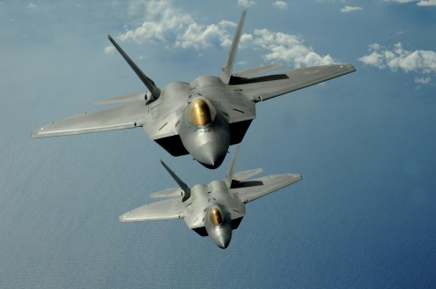
Council Meeting Objectives
1. Focus on activities that can support the chapters; to help them grow their membership
2. Share chapter successes and look for solutions to issues and concerns
3. Update the group on state and national legislative issues and support for active duty and veterans

Slide 6

Agenda
Welcome, Admin
Last Meeting Review
Reporting Requirements
Chapter Reports
Budget Approval
Restructure Council Meetings
Chapter Sharing
Sponsorship, Grants
Membership
Legislative
MOAA National
Desmond Doss Foundation
Meeting Review
Use Easels to capture Issues Actions

Slide 7
Last Meeting
Discussion from SENCLAND
Action: Restructure Council Meetings
Reporting
How did we do?
2018 Budget
Presentation and Approval

Slide 8
Chapter Sharing
In your Regional Groups, discuss:
SUCCESSES What makes your chapter successful? What brings your members to meetings, what generates enthusiasm, what engages your members?
ISSUES What are the issues that your chapter struggles with? What are barriers to members enthusiasm and commitment?
ACTION What are you doing to mitigate/solve these issues? What is your strategy, tactics for improvement?
Be prepared to report back to Council Group in 20 minutes with a brief overview of the highlights of your discussions.

Slide 9

MOAA Goals 2019
Ensure any TRICARE reform sustains access to top-quality care.
Prevent disproportional TRICARE fee increases.
Sustain military pay comparability with the private sector.
Stop erosion of compensation and non-pay quality-of-life benefits.
End financial penalties for military survivors.
End concurrent receipt penalties for military retirees.
Achieve equity of benefits for Guard and Reserve members with their active duty counterparts.
Strengthen DoD-VA collaboration and services to support wounded warriors and an expanding population of women veterans.
Ensure timely access to service-earned VA benefits.
Protect military and veteran family support programs and policies.

Slide 10
MOAA National Update
Community Outreach Grant
Up to $5,000
Deadline 28 February
See MOAA Web Site
Requires Liability Insurance
USAA/MOAA Sponsorship
Apply 60 days in advance
Limited budget
Recognize USAA
Personalize Your MOAA Newsletter
EMAIL PREFERENCE CENTER
Legislative Action Center
Review web page

Slide 11
MOAA National Update
Community Outreach Grant
http://www.moaa.org/foundation/#Community-Outreach
USAA/MOAA Sponsorship
http://test.moaa.org/Content/Chapters-and-Councils/Council-and-Chapter-Management/USAA-Sponsorship-for-MOAA.aspx
Personalize Your MOAA Newsletter
http://moaa.highroadsolution.com/moaa_preference_page/EmailSearch.aspx
Legislative Action Center
http://takeaction.moaa.org/?0

Slide 12

Membership
Col Al Shroetel, USAF, Ret
SENCLAND Membership Chair
What does it take to get new members and keep the ones you have?
Al was awarded MOAA Leadership Award September 2018 at the Leadership Conference in Greenville, SC

Slide 13
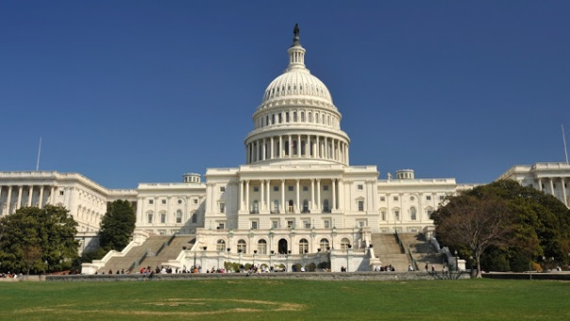
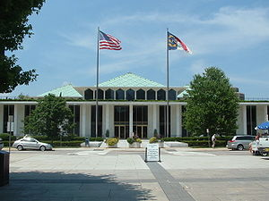

Legislative
Legislative Plans
Storming the Hill
NC Legislature
4th Branch

Slide 14

Meeting Review
Did we meet our objectives?
1. Focus on activities that can support the chapters; to help them grow their membership
2. Share chapter successes and look for solutions to issues and concerns
3. Update the group on state and national legislative issues and support for active duty and veterans
Positive highlights
Areas for improvement
Actions Review

Slide 15
Committee Module Training Webinar
Webinar is concise and complete, 11:40 in duration
Find it on the MOAA Web (login required)
Councils and Chapter Management
Webinars
Committee Module Training Webinar
Hot Link
Or http://www.moaa.org/Content/Chapters-and-Councils/Council-and-Chapter-Management/Committee-Module-Training-Webinar.aspx

